Slide 1
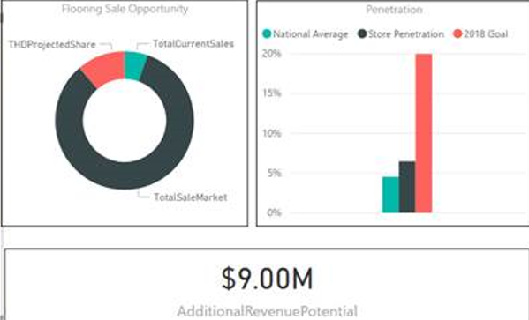
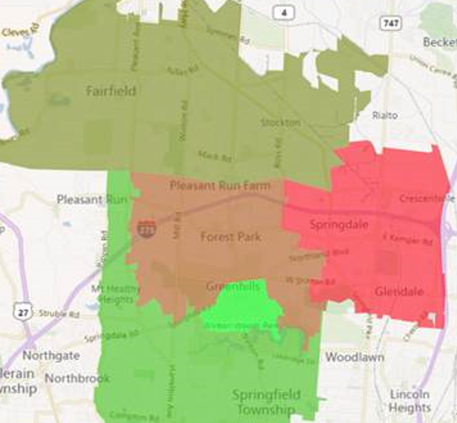
D23 Install Market Share – #takeyourshare23
Why Market Share? 1% of national market share gain = $67M
Campaign Overview
Store 3821 – Forest Park Example
Rollout Plan – Feb ‘18
Educate stores on their specific market share
Use Twitter, Instagram, weekly updates to inspire, educate, track progress, update
Use SMM in March to further reinforce launch
Services Field, HDMS, installer engagement will be key driver for campaign success
56,736 – housing units in assigned zip codes
Assumption: homes in these zip codes get flooring installation every 12-15 years
4,728 – annual market size of local flooring installs
306 – flooring installs completed by Store 3821
Notes:
25% of Roll Bar Sales are as special orders

Slide 2
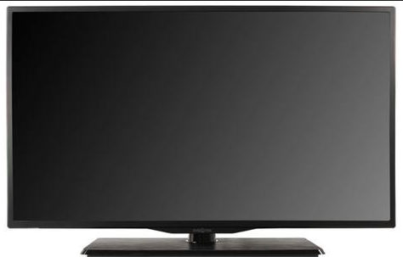
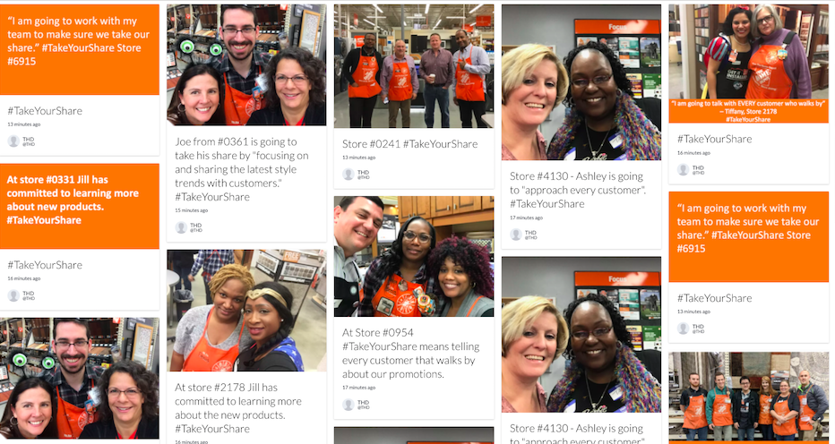
2018 #TakeYourShare Campaign
The photos and comments you capture will be displayed at the 2018 Store Manger’s Meeting in Las Vegas!
Store Managers committing to “TakeYourShare” will be photo'd at the booth
Notes:
The Carpet industry is a $10 Billion a year business.
But THD only takes 15% of the market share.
If we get into a customer’s home for an estimate, HDMS closes 75% of all jobs.
So why aren’t we taking more share?

Slide 3
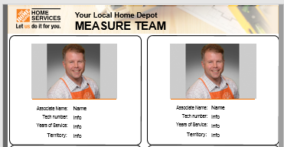
2018 #TakeYourShare Campaign for HDMS
HDMS: Market Managers and Measure Techs
Feb, March – HDMS visit stores with #TakeYourShare23 campaign
HDMS gives the “Meet your Measure Tech” slide
HDMS rep updates slide with technician ID pictures.
HDMS states R12 market share: “We did 300 installers last year, but there are 45,000 houses assigned to this store!”
HDMS state: “We have the capacity to take 25% more market share today! We can do measures within 1 – 2 days of receiving the PO. Sell with confidence!”
HDMS asks: “How can I help you take your share?”
Use the newest data from the HDMS Q1 Specialty Tuesday ppt and Tri-Fold to help answer questions
HDMS asks: “How will you take your share?”
Keep the focus on qualifying every customer in showroom and scheduling the measure
Take Pictures of Associates & post their “take your share” response
Tweet photos and responses to #TakeYourShare23. Photos will be displayed at 2018 Store Manager’s Meeting in Las Vegas
Notes:
The Carpet industry is a $10 Billion a year business.
But THD only takes 15% of the market share.
If we get into a customer’s home for an estimate, HDMS closes 75% of all jobs.
So why aren’t we taking more share?

Slide 4
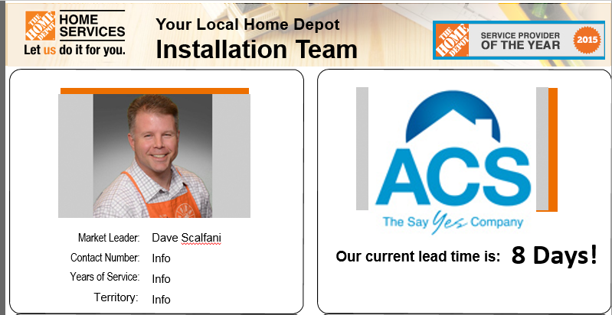
2018 #TakeYourShare Campaign for Installers
Installers:
Feb, March – Installers visit stores with #TakeYourShare23 campaign
Installer states R12 market share: “we did 300 installers last year, but there are 45,000 houses assigned to this store!”
Installers state: “we have the capacity to take 25% more market share today! We can do installers within 3 day of receiving product. Sell with confidence!”
Installer hands out their contact list and lead time sheet
Installer asks: “how can I help you take your share?”
Installer asks: “how will you take your share?”
Take Pictures of Associates & post their “take your share” response
Tweet photos and responses to #TakeYourShare23. Photos will be displayed at 2018 Store Manager’s Meeting in Las Vegas
Notes:
The Carpet industry is a $10 Billion a year business.
But THD only takes 15% of the market share.
If we get into a customer’s home for an estimate, HDMS closes 75% of all jobs.
So why aren’t we taking more share?

Slide 5
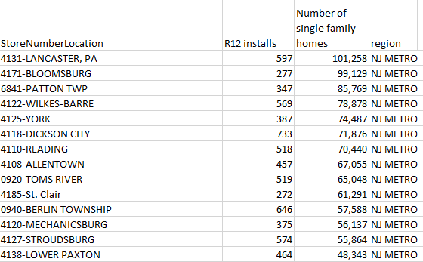
2018 #TakeYourShare Campaign for DSM
DSM: During regularly scheduled Visits! No special trips for this!
Feb, March – DSMs visit stores with #TakeYourShare23 campaign
DSM states R12 market share: “we did 300 installers last year, but there are 45,000 houses assigned to this store!” We have room to grow the business
DSM state: “We have never been better! Truly Free, Advertising, new products, new showrooms!”
DSM asks: “how can I help you take your share?”
DSM asks: “how will you take your share?”
Take Pictures of Associates & post their “take your share” response
Tweet photos and responses to #TakeYourShare23. Photos will be displayed at 2018 Store Manager’s Meeting in Las Vegas
Notes:
The Carpet industry is a $10 Billion a year business.
But THD only takes 15% of the market share.
If we get into a customer’s home for an estimate, HDMS closes 75% of all jobs.
So why aren’t we taking more share?

